Slide 1
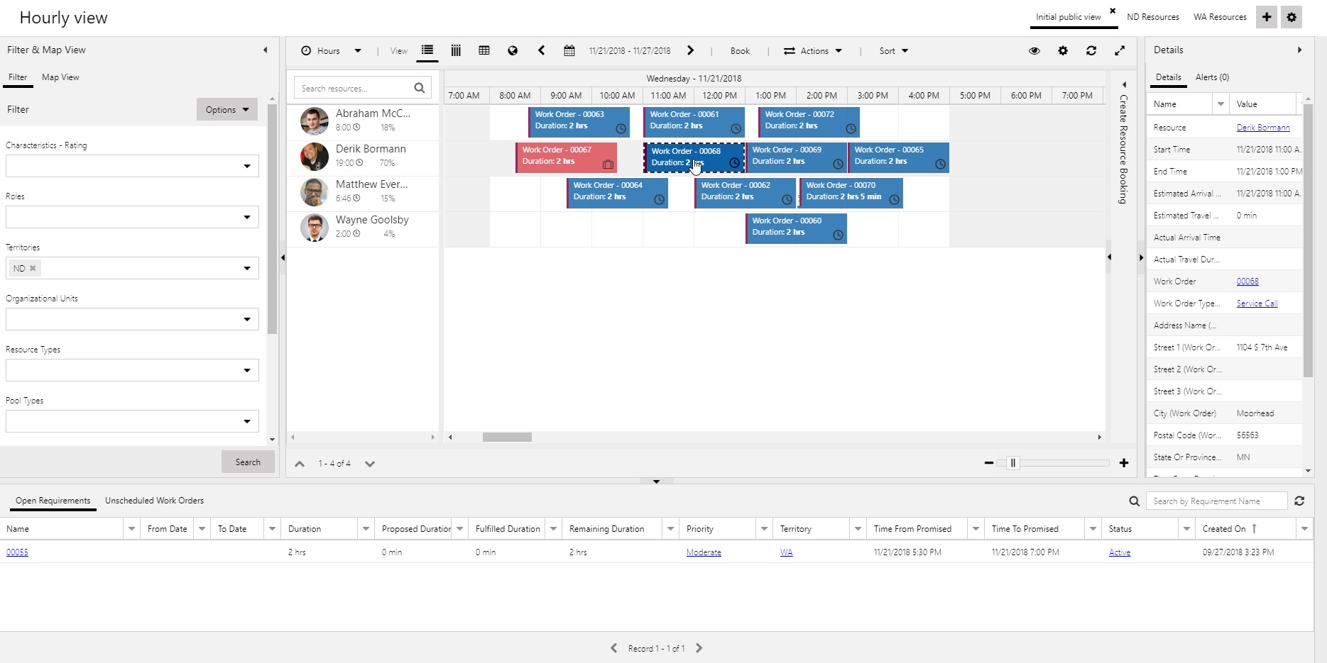
Schedule Calendar
Filter & Map View Pane
Details Pane
Resource Requirements.

Slide 2
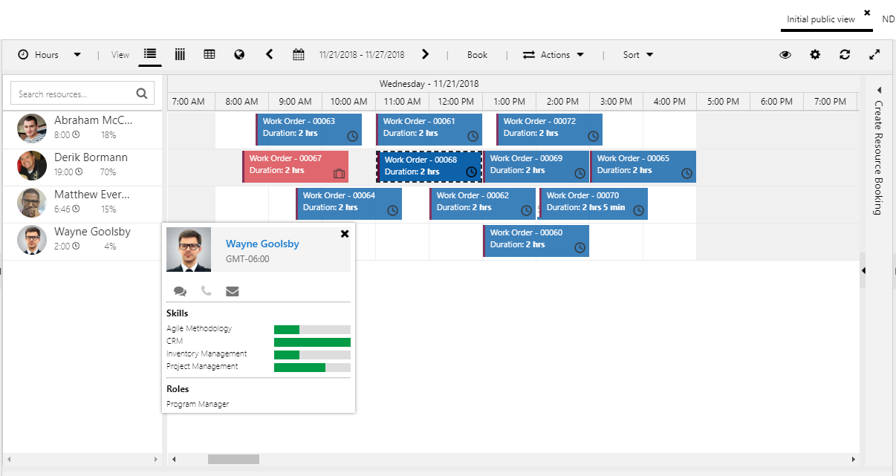
Toolbar can be used for items such as changing the view, changing dates, or executing actions on records
Shows current total and % scheduled
Resource card displays a resources skills, roles, and provides communication options

Slide 3
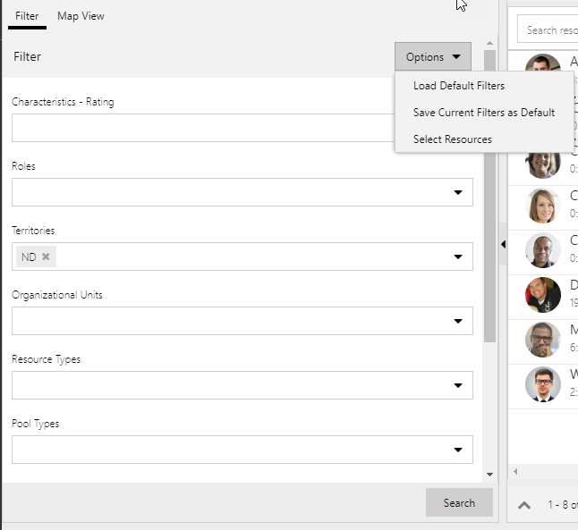
Lets you pre-select the resources displayed. Filter criteria is applied only to selected resources
Applies the filter criteria defined

Slide 4
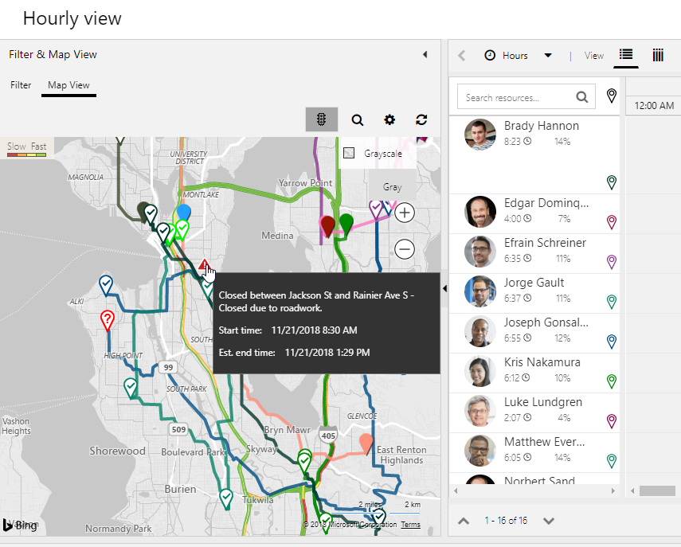
Items can be searched
Unscheduled item
Traffic and road closure information
Resources route is created as items are added

Slide 5
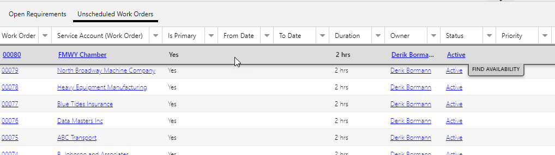
Easily switch between different types of requirements
Items can be scheduled directly from the requirements panel

Slide 6
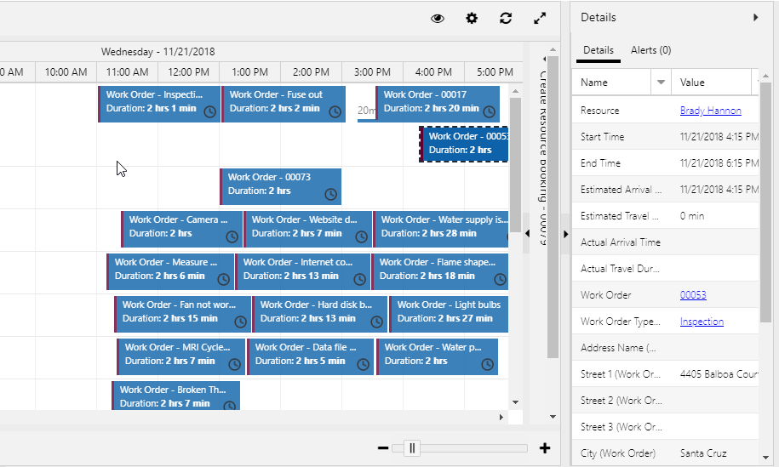
Details displayed based on the item that is currently selected.

Slide 7
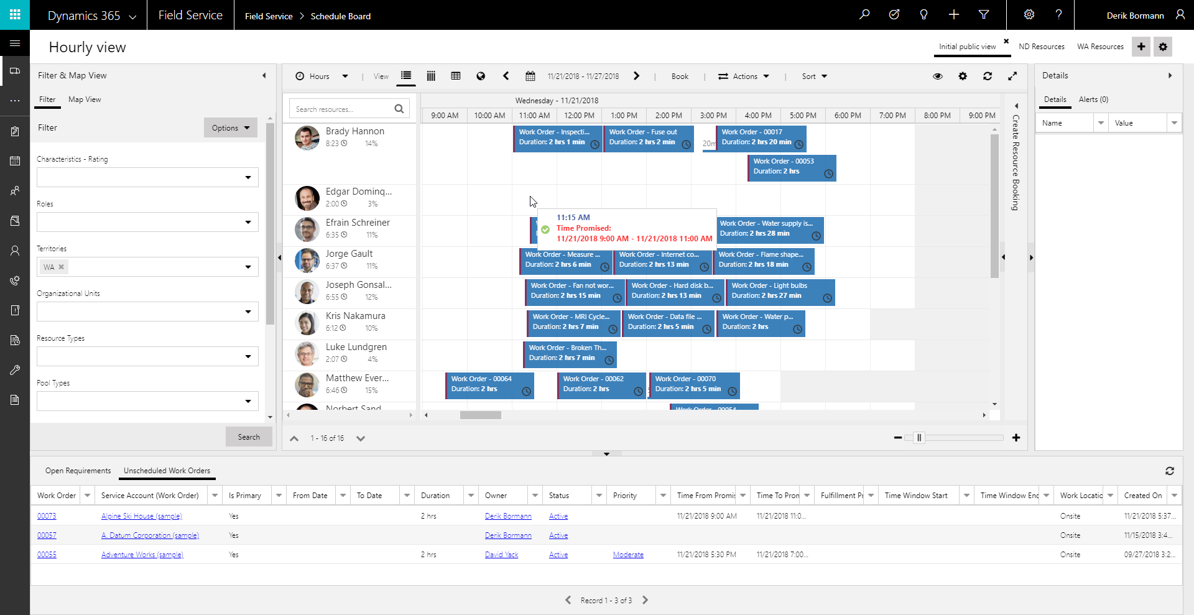
As item is being placed, text color is changed to show it you are in or out the window promised to the customer

Slide 8
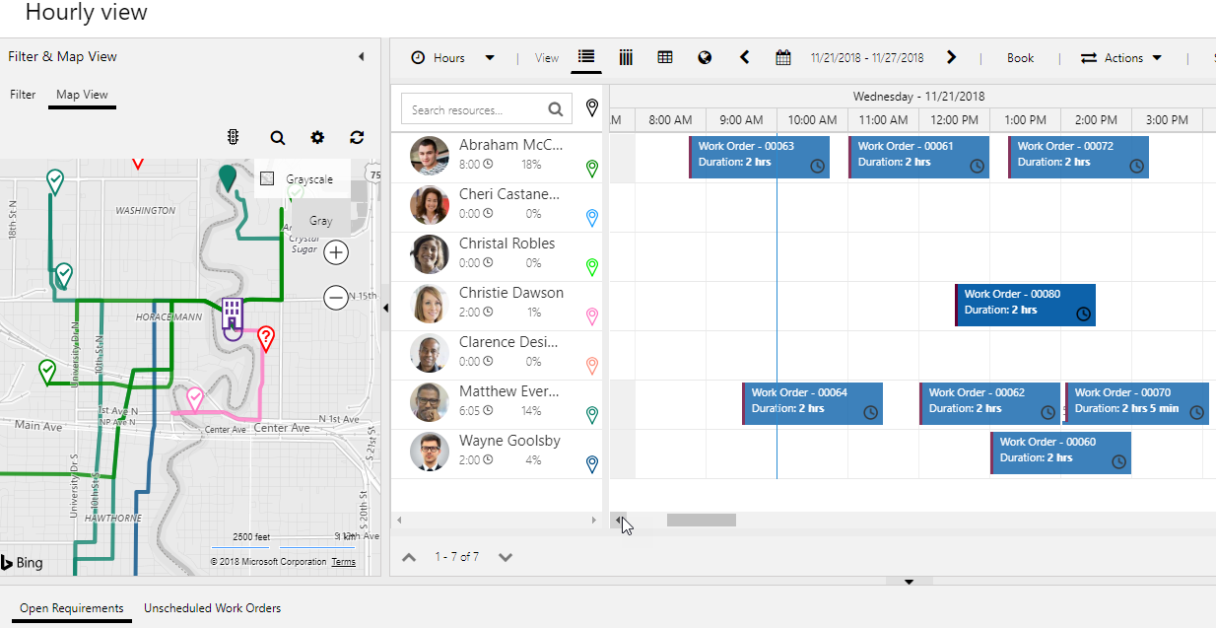
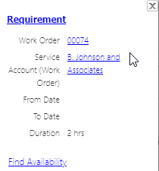
Unscheduled item
Unscheduled item
Estimate: 2 hours

Slide 9
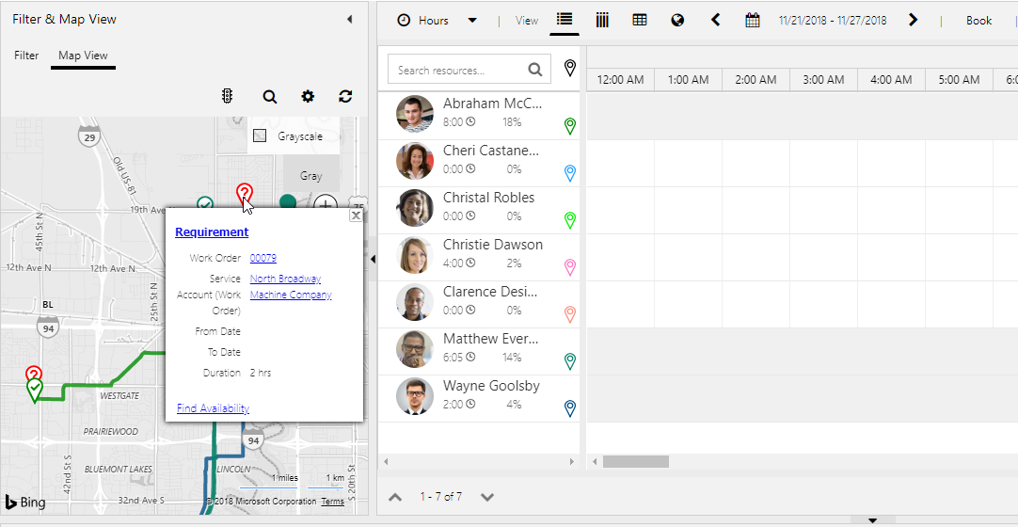
Launches the Schedule Assistant

Slide 10
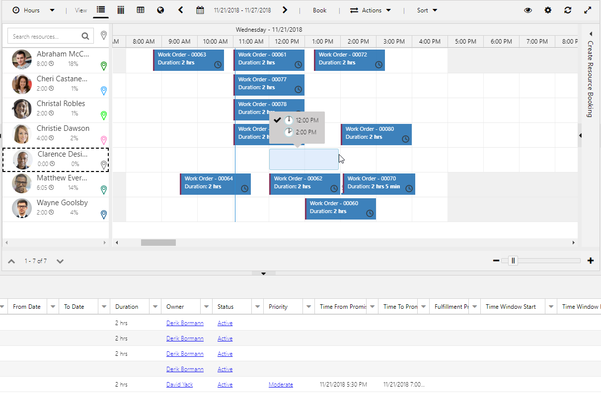
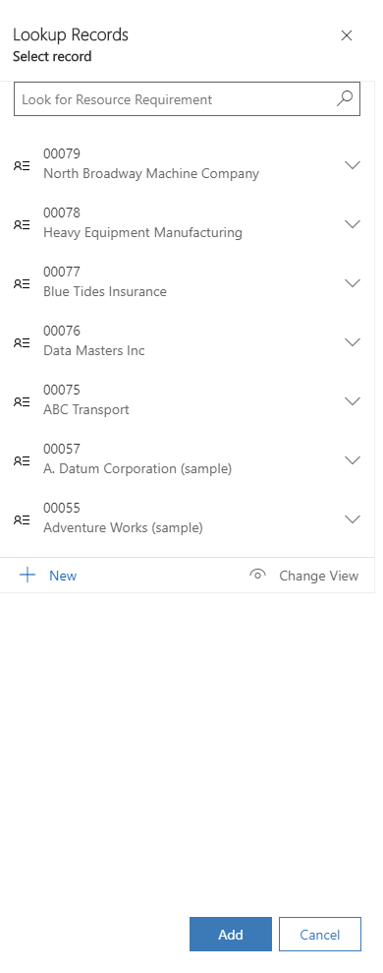
Defines the time to block out
Select a requirement from the list and click add to generate the booking

Slide 11
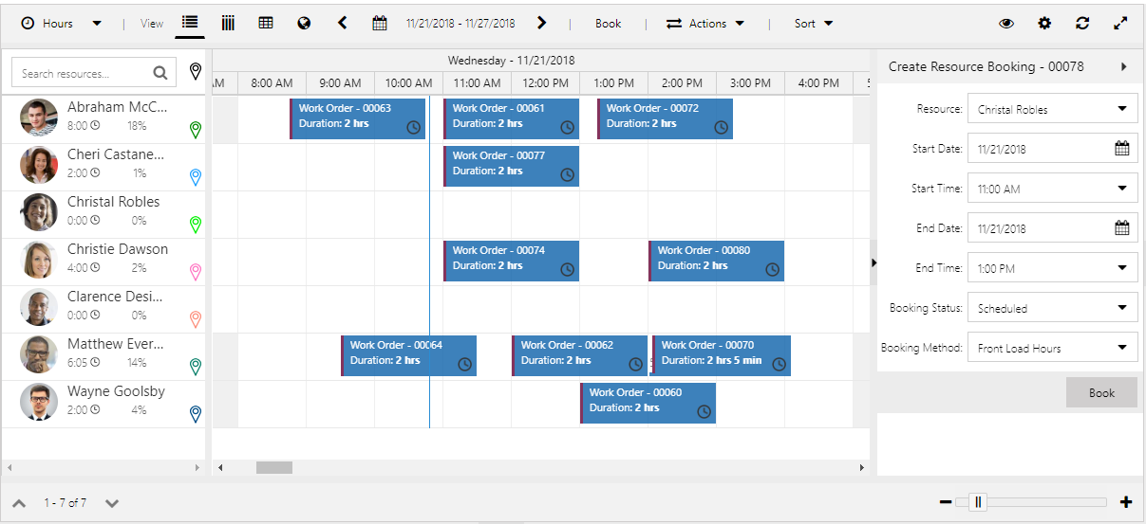
Expands the Create Resource Booking Panel
Creates and schedules the booking

Slide 12
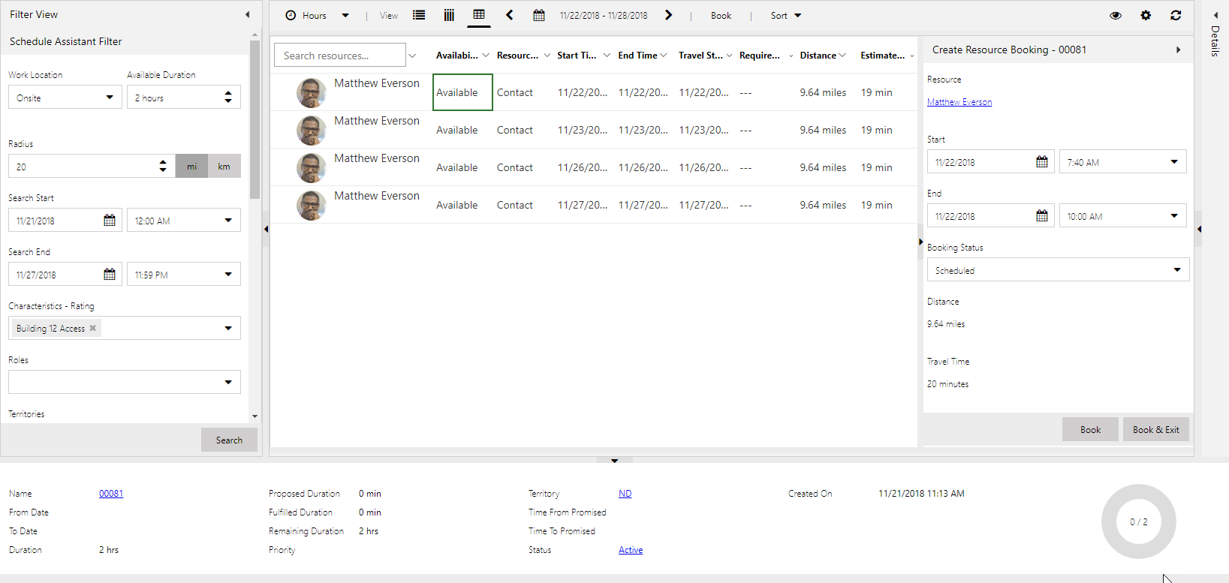

Slide 13
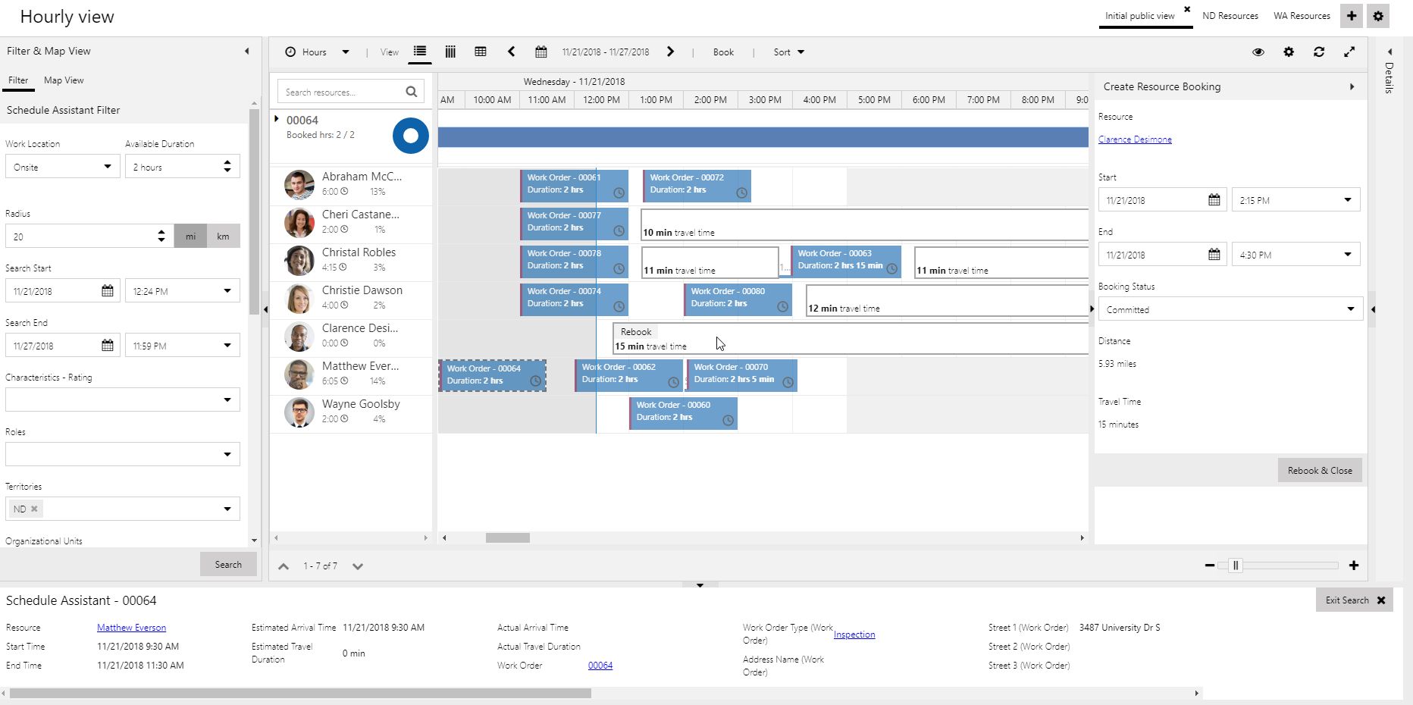
Original Booking
Time window include travel time estimate
Moves the booking to the new time and/or resource

Slide 14
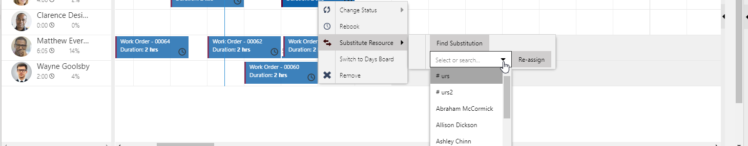
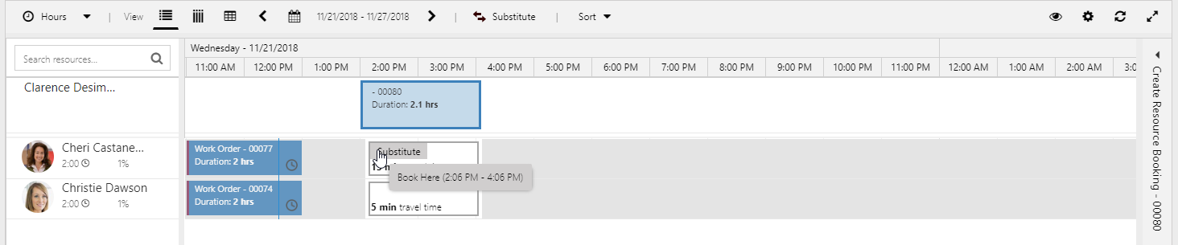
Lets you specify a specific resource to substitute.
Schedule Assistant Window
Assigns the booking to the new resource at the original time.

Slide 15
